Slide 1
FERTILISATION OVERVIEW
Fertilisation -secondary oocyte nucleus is joined to a sperm nucleus- forms a diploid nucleus.
Secondary oocyte is only able to be fertilised for 1 day after ovulation.
Sperm remain viable for 1-3 days.
Fertilisation can only occur if sperm is deposited into the female reproductive system (insemination) no earlier than 3 days prior to ovulation & no later than 1 day after ovulation (4 day window).

Slide 2
FERTILISATION STEPS
1. The many sperm break down the corona radiata.
2. Sperm break through corona radiata and bind to zona pellucida
3. Sperm heads release enzymes which tunnel through the zona pellucida.
4. The first sperm through and binding to the secondary oocyte loses its flagellum and is drawn into the oocyte cytoplasm.

Slide 3
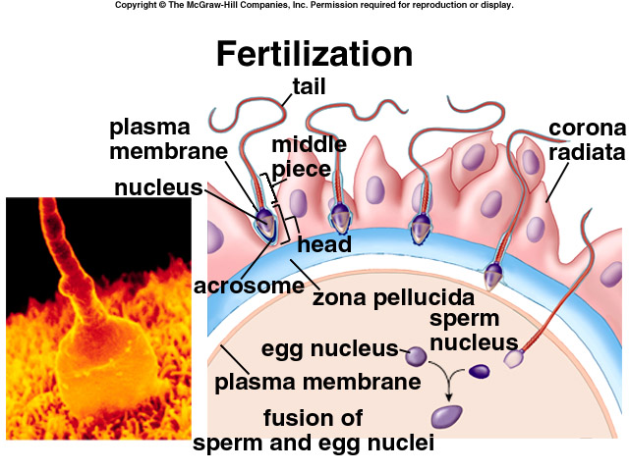

Slide 4
FERTILISATION steps
5. Secondary oocyte completes the second meiotic division
6.Each nucleus of the oocyte & sperm head swell (pronuclei), rupture and both sets of chromosomes come together to form one nucleus-a diploid zygote.

Slide 5
FROM ZYGOTE TO BLASTOCYST
The zygote takes 3 to 4 days to travel to the endometrium in the uterus.
The zygote undergoes cleavage (many mitotic cell divisions) to create more cells for the formation of a morula.
A blastocyst is formed about 4 days after conception.

Slide 6
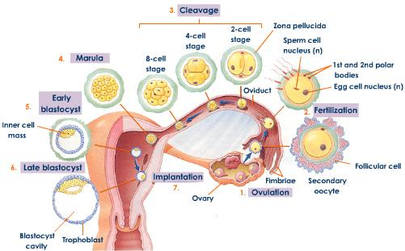
ZYGOTE TO BLASTOCYST

Slide 7
BLASTOCYST STRUCTURES
The blastocyst consists of:
an inner cell mass which later becomes embryo structures.
A hollow fluid filled cavity (called blastocoel)
An outer layer of cells (trophoblast) which allow the blastocyst to burrow into the endometrium (implantation). These cells grow into chorionic villi which then form the placenta.
Implantation occurs 7 days after ovulation.

Slide 8
HORMONAL MAINTENANCE OF THE ENDOMETRIUM
The corpus luteum releases progesterone & oestrogen to maintain the endometrium until the placenta develops.
Without blastocyst implantation, the corpus luteum would break down & FSH would be released by the pituitary to start the ovarian cycle.
The trophoblast of the blastocyst has become the chorionic villi. Chorionic villi secrete Human chorionic gonadotropin which maintains the corpus luteum.

Slide 9
ENDOMETRIUM MAINTENANCE
The maintained corpus luteum keeps the endometrium lining from being shed.
The placenta takes 3 months to develop from the finger- like projections of the chorionic villi. Once developed, it maintains the endometrium by releasing oestrogens & progesterone.

Slide 10
PLACENTA DEVELOPMENT
Chorionic villi are small finger like projections that burrow into the endometrium.
As they burrow further into the endometrium, the chorionic villi become surrounded by the mother's blood. This increases the surface area for exchange of substances (o2, co2, glucose etc).
Mother's (maternal) & foetal (foetus after 2 months) blood never mix. Substances move across the cell layers by diffusion or active transport.

Slide 11
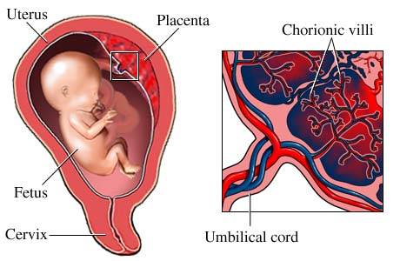

Slide 12
PLACENTA FUNCTIONS
Endocrine organ that releases HCG (from chorionic villi) to maintain the corpus luteum initially.
Fully formed, it releases its own estrogens & progesterone to maintain the endometrium.
Provides a passage for nitrogenous wastes (urea, ammonia, uric acid etc) to pass into the maternal blood so that the mother's kidneys can excrete.
Transports antibodies from the mother to provide immunity.

Slide 13
PLACENTA FUNCTIONS Cont...
Transports glucose, fatty acids, amino acids, minerals and vitamins to the foetus from the mother.
Transports oxygen into the fetal blood supply & co2 into the mother's blood supply.
NOTE: Fetal lungs aren't functioning.

Slide 14
PLACENTA BLOOD SUPPLY
Placenta is attached to the foetus by the umbilical cord.
The umbilical cord has two umbilical arteries that carry blood near the chorionic villi capillaries (i.e. deoxygenated, waste filled blood carried toward the foetal chorionic villi).
One umbilical vein takes blood away from foetus (i.e. oxygenated, nutrient filled blood carried away from the foetal chorionic villi.

